Slide 1

Notes:
Welcome and Thanks
Intro to me & group

Slide 2
We all have mental health

Slide 3
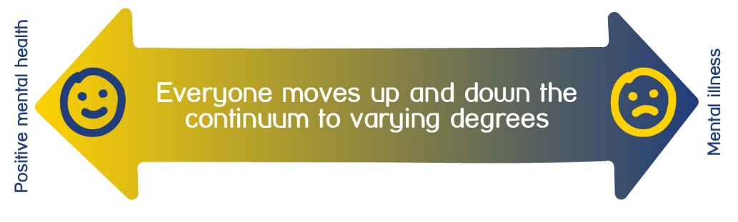
  Good mental health means we generally feel able to cope. We can think about things in a calm way. And we’re able to understand and express our emotions in helpful ways.
  Poor mental health means that the way we think, feel or behave is difficult to cope with. We might stop enjoying things. Or we might not want to be around people as much. It can look different for everyone.

Slide 4

Mental Health in the UK
1 in 6
Working age adults experience symptoms of anxiety of depression in any given week in England
1 in 4
In England will experience a mental health problem at some point each year
1 in 5
Children and young people in England have a mental health difficulty
1 in 6
Working-age adults experience symptoms of anxiety or depression in any given week in England.
2 Million
People on waiting lists for NHS mental health support in England alone
x8
More likely to wait over 18 months for mental health treatment then physical health treatment
7000
People die by suicide each year in the UK
Notes:
https://www.rethink.org/news-and-stories/media-centre/2025/02/new-analysis-of-nhs-data-on-mental-health-waiting-times
Suicide – 1671 people were killed on the road in the UK in 2024. Compared to 7000 by suicide. And think about how much awareness is raised around safe driving.

Slide 5
Mental Health in Harrogate District
1 in 6
Working age adults experience symptoms of anxiety of depression in any given week in England
12%
Of adults in Harrogate district have depression or anxiety
72%
Of Young People told Healthwatch NY they had experienced a mental health issue in the last 12 months
34%
Of adults in Harrogate district said their mental health worsened due to cost-of-living pressures
6months+
People on waiting lists for an assessment with the Community Mental Health Team – up to 18months in Ripon area
189 per 100,000
Hospital admission for self-harm in Harrogate compared to 184 per 100,00 in UK
13 per 100,000
Suicide rate in Harrogate, compared to 10 per 100,000 in UK

Slide 6
Support for people with Mental Health Challenges
Primary Care
NHS Talking Therapies
Secondary Care
Tertiary Care
Voluntary and community sector
Crisis and emergency support
Private sector
Digital support
Notes:
1. Primary Care (First-Line Support)
Where most people start when seeking help.
GP (General Practitioner)
Usually the first point of contact for discussing mental health.
Can prescribe medication (e.g., antidepressants) and refer to other services.
Some practices have first contact mental health practitioners or social prescribers
Barrier: time to get an appointment, appointment times are short, and continuity can be limited.
NHS Talking Therapies
Free CBT therapy service for mild-to-moderate depression, anxiety, phobias, trauma, etc. Self-referral is possible in most areas.
Barrier: long waiting lists (often 6–18 weeks or more).
2. Secondary Care (Specialist Community Services)
For people with more complex, long-term, or severe conditions.
Community Mental Health Teams (CMHTs)
Multidisciplinary teams (psychiatrists, nurses, social workers, psychologists).
Support adults with severe or enduring mental illness (e.g. bipolar disorder, schizophrenia, recurrent depression).
Offer care coordination, medication management, and social support.
Referral via GP.
Early Intervention in Psychosis (EIP) Teams
For young people or adults experiencing first-episode psychosis.
Aim to reduce long-term impact through intensive early support.
Assertive Outreach or Recovery Teams
Provide longer-term, community-based care for people who struggle to engage with mainstream services.
Home Treatment / Crisis Resolution Teams (CRTs)
Offer intensive short-term support at home as an alternative to hospital admission.
Typically available 24/7, though response times vary.
3. Tertiary Care (Inpatient and Specialist Units)
For people in acute crisis or with highly complex needs.
Psychiatric Inpatient Wards / Hospitals
For people at significant risk to themselves or others.
May be accessed voluntarily or under the Mental Health Act (sectioning).
Average stay is often short; can be traumatic or stigmatising experiences.
Specialist Units
e.g., Eating disorder units, mother-and-baby units, forensic mental health wards.
4. Voluntary & Community Sector (Charities, Peer Support, Social Prescribing)
Often more accessible, less clinical, and crucial for ongoing support.
Charities like Mind, Rethink Mental Illness and Samaritans
Offer information, peer groups, advocacy, and crisis lines.
Fill the gaps when statutory services are overstretched.
Peer Support Groups
Run by people with lived experience; build confidence, reduce isolation.
Recovery Colleges & Social Prescribing Schemes
Provide courses, community activities, volunteering to aid recovery and wellbeing.
Faith-based or cultural community projects
Often more approachable for people from diverse backgrounds.
5. Crisis & Emergency Support
For people in immediate distress or at risk of suicide.
Samaritans (24/7) – listening and emotional support.
NHS 111 (option 2) – connects to local mental health crisis lines.
Local Crisis Cafés / Safe Havens – drop-in spaces for people in distress.
A&E Departments – often the only available option out of hours, though not ideal.
Police / Street Triage Teams – joint mental health–police response for crises.
6. Private & Digital Services
Useful but limited by cost and access.
Private Counselling / Therapy – face-to-face or online (e.g. BACP, Counselling Directory).
Online platforms – BetterHelp, Kooth (for young people), Togetherall.
Employee Assistance Programmes (EAPs) – counselling through workplaces.
Apps for self-help – Calm, Headspace, Mindshift (for anxiety), Thrive.
Barrier: affordability and digital exclusion — not everyone can use or trust online help.

Slide 7
National Mind helplines
Infoline: 0300 123 3393 (Mon – Fri, 9am – 6pm)
Welfare benefits line: 0300 222 5782 (Mon – Fri, 9am – 5pm)
Legal line: 0300 466 6463 (Mon – Fri, 9am – 6pm)
Support line: 0300 102 1234 (Mon – Fri, 9am – 6pm)
Notes:
Infoline: 0300 123 3393
Ask us about:
Mental health problems
Where to get help near you
Treatment options
Advocacy services
Welfare benefits line: 0300 222 5782
Our welfare benefits line supports anyone with mental health problems who is navigating the benefits and welfare system.
Ask us about:
The benefits you may be entitled to
Cost of living support
Personal Independent Payment, Universal credit and other types of benefit
Benefit appeals
Legal line: 0300 466 6463
Our Legal line offers legal information and general advice on mental health related law in England and Wales.
Ask us about:
Being detained under the Mental Health Act (sectioning)
Mental capacity
Community care
Discrimination and equality
Support line: 0300 102 1234
Our support line is a safe space for you to talk about your mental health. Our advisors are trained to listen to you and help you find specialist support if you need it.
Talk to us if:
You want a safe and confidential place to talk openly about your feelings
You want someone to listen to you and help you to find the right steps to take for your mental health
You're looking for emotional support for your mental health and wellbeing

Slide 8

Self care
Self care is looking after yourself by doing things you enjoy that make you feel better.
It can improve mood, decrease stress and help you to appreciate yourself.
At Mind in Harrogate District, we recommend the Five Ways of Wellbeing developed by the New Economics Foundation that can make a positive difference to our wellbeing if carried out on a regular basis.
Notes:
Looking after ourselves when we are not feeling ourself can also help us feel better, it can improve our mood, decrease stress and help us to appreciate ourselves more.
Five ways of wellbeing provides some ideas as to how we can look after ourselves.

Slide 9
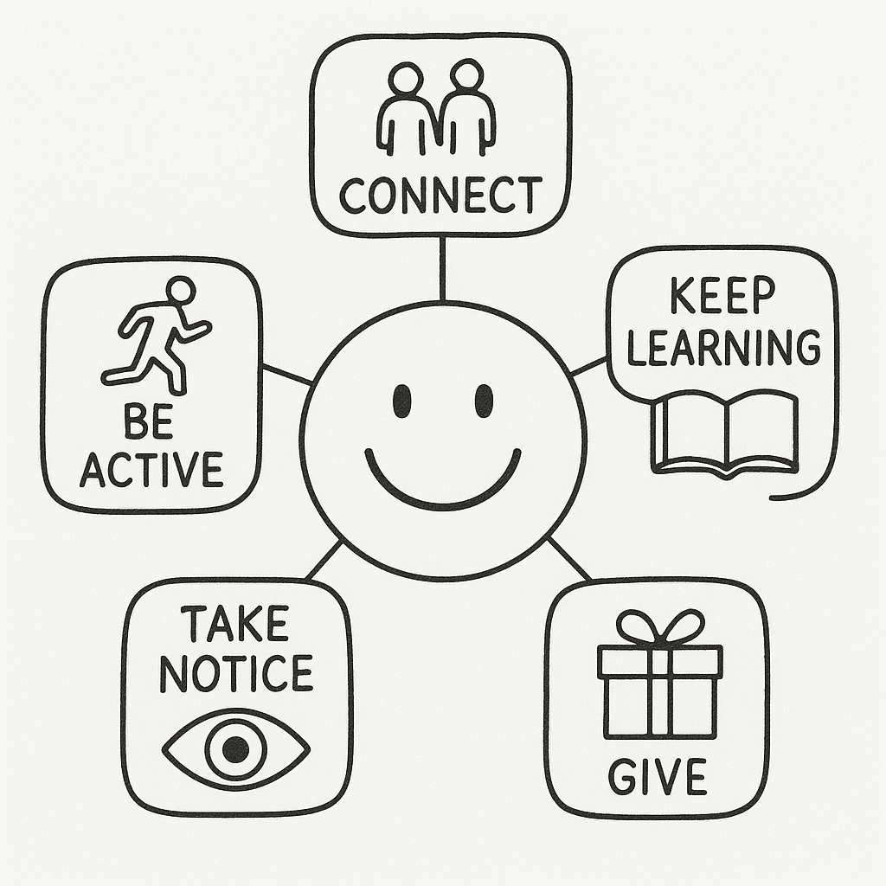
5 Ways of Wellbeing

Slide 10
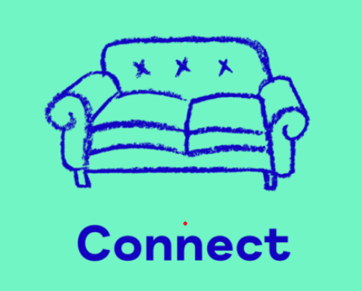
Connect
Positive relationships are important for keeping up our spirits. Take time to engage with others and express an interest. Making an effort to be sociable and really listen will improve your sense of wellbeing.
Embrace the moment and have a chat
Ask someone how they are feeling and really listen
Speak to someone new and find a shared interest
Notes:
Encourage AUDIENCE to reflect on these 5 ways and think about what they could do for themselves.
Connect​
(Build relationships with people around you)​
Why it helps​
Humans are social mammals. Our nervous systems regulate best in safe relationships.​
Biological effects:​
Increases oxytocin (calming, bonding hormone)​
Reduces cortisol (stress hormone)​
Activates the parasympathetic (“rest and digest”) nervous system​
Psychological effects:​
Increases sense of belonging and safety​
Buffers against anxiety and depression​
Helps us process emotions through shared meaning​
Bottom line:​
Connection tells your brain: I am safe; I matter.​

Slide 11

Be Active
Exercise not only keeps our bodies healthy, it makes us feel good too. Incorporate low-impact physical activity into daily life. Getting out and about or simply moving more will boost your mood.
Do some stretches or go for a walk
Join a running club or sports group
Organise a group sporting activity
Notes:
Encourage AUDIENCE to reflect on these 5 ways and think about what they could do for themselves.
Be Active​
(Move your body regularly)​
Why it helps​
Movement is one of the fastest ways to influence mood because it directly affects brain chemistry.​
Biological effects:​
Releases endorphins (natural painkillers)​
Increases dopamine and serotonin (motivation and mood)​
Improves sleep and reduces inflammation​
Psychological effects:​
Improves self-efficacy (“I can do things”)​
Breaks cycles of rumination​
Regulates stress and anxiety​
Bottom line:​
Movement resets the nervous system and improves emotional balance.​
​
​

Slide 12

Take Notice
Being mindful and observant allows us to appreciate the world around us.
Reflect on what it is you value and make positive choices. Savouring the moment and enjoying the environment will enhance your self-understanding.
Explore your local area and visit new places
Appreciate nature and wildlife
Think how other people might be feeling
Notes:
Take Notice​
(Be mindful, present, aware)​
Why it helps​
Noticing interrupts autopilot and helps the brain process emotions instead of being overwhelmed by them.​
Biological effects:​
Strengthens the prefrontal cortex (emotion regulation)​
Calms the amygdala (threat detection system)​
Psychological effects:​
Increases emotional awareness​
Reduces overthinking and reactivity​
Builds appreciation and gratitude​
Bottom line:​
Attention shapes experience—what you notice, you feel more deeply.​
​
​
Take Notice​
(Be mindful, present, aware)​
Why it helps​
Noticing interrupts autopilot and helps the brain process emotions instead of being overwhelmed by them.​
Biological effects:​
Strengthens the prefrontal cortex (emotion regulation)​
Calms the amygdala (threat detection system)​
Psychological effects:​
Increases emotional awareness​
Reduces overthinking and reactivity​
Builds appreciation and gratitude​
Bottom line:​
Attention shapes experience—what you notice, you feel more deeply.​
​
​

Slide 13

Keep Learning
Gaining new skills or developing existing talents enhances self-esteem and builds confidence. Set a goal, make a plan and learn something new. Continued learning throughout life will satisfy your curiosity and encourage social interaction.
Read a book
Research a subject
Sign up for a course or class
Notes:
Keep Learning​
(Try new things, develop skills)​
Why it helps​
Learning keeps the brain flexible and gives a sense of progress and purpose.​
Biological effects:​
Promotes neuroplasticity (the brain’s ability to adapt)​
Activates reward pathways linked to mastery​
Psychological effects:​
Builds confidence and resilience​
Supports identity beyond stress or illness​
Creates hope through growth​
Bottom line:​
Learning reminds us that we are still growing, not stuck.​

Slide 14

Give
Sharing our time, energy or knowledge gives us purpose and makes us feel valued. Participation in social and community life will increase your wellbeing and make you feel good. Committing an act of kindness not only makes someone else happy but boosts your own wellbeing too.
Compliment or praise someone
Offer your help or assistance
Get involved with a community project
Notes:
Give​
(Do something kind for others)​
Why it helps​
Giving activates reward systems more reliably than receiving.​
Biological effects:​
Triggers dopamine and oxytocin​
Reduces stress responses​
Activates “helper’s high”​
Psychological effects:​
Increases meaning and purpose​
Reduces self-focused rumination​
Strengthens social bonds​
Bottom line:​
Helping others reinforces the feeling that your life has value.​

Slide 15








Our services in Harrogate district
Counselling & Telephone Support
Emergency Department Support
Rural
Wellbeing Support
Children & Young
People support
Befriending in the community
Wellbeing & Peer Support Groups

Slide 16
Visit our website for more information about our services: mindinharrogate.org.uk

